Slide 1
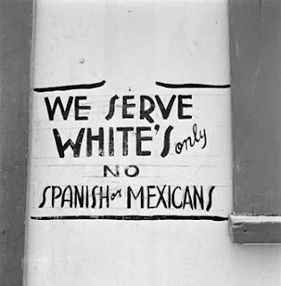
Bell Ringer: What group do you think was excluded from this establishment? Why?

Slide 2
On the Home Front Minorities in War
Home Front Contributions

Slide 3
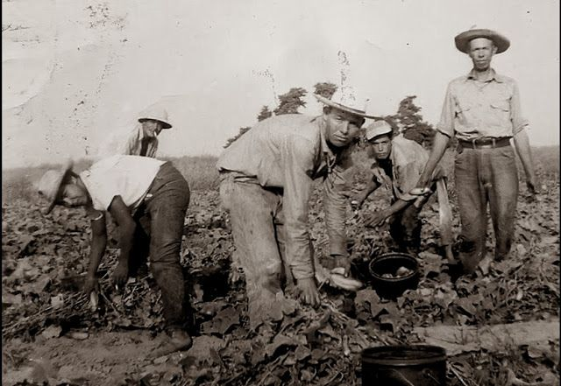
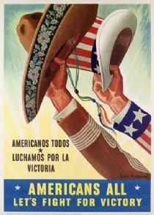
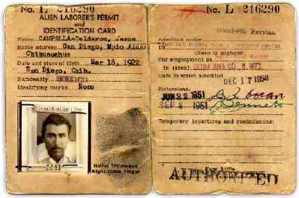
Hispanic Laborers in WWII
Labor shortage due to war; agriculture in greater demand due to war
Bracero Program (1942-64): Hired Mexican citizens to work U.S. agriculture
~4 million workers
US farmers became dependent on Braceros for inexpensive labor
Harsh treatment

Slide 4
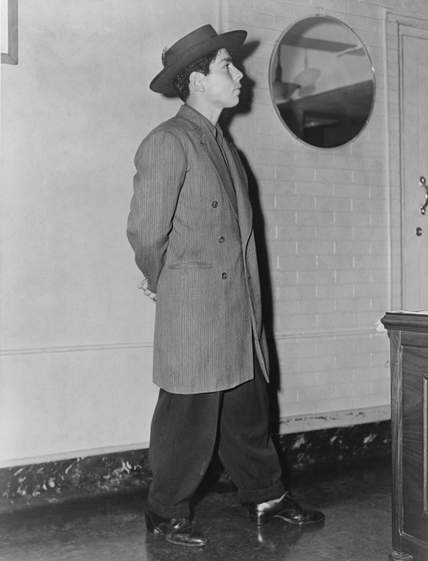
Who Wore it Better?
The Victory Suit
The Zoot Suit

Slide 5
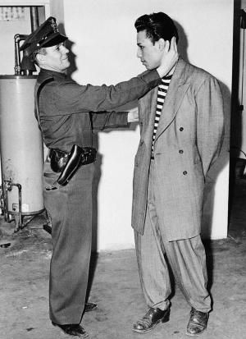
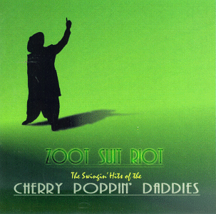
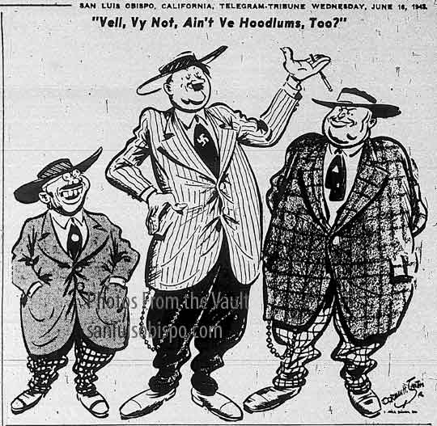
Zoot Suit Riots
Zoot suits popular with Latino youth
Seen as unpatriotic
Racial undertones
Zoot Suit Riot: Racially motivated riot in LA between white sailors and Latino youth

Slide 6
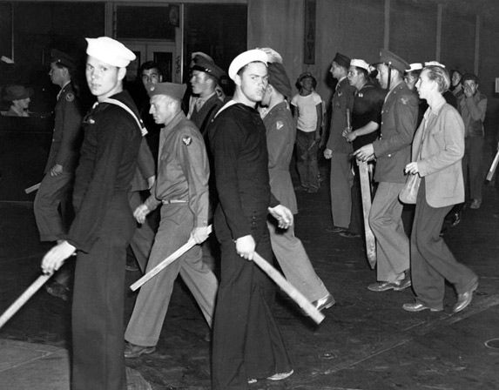

Slide 7
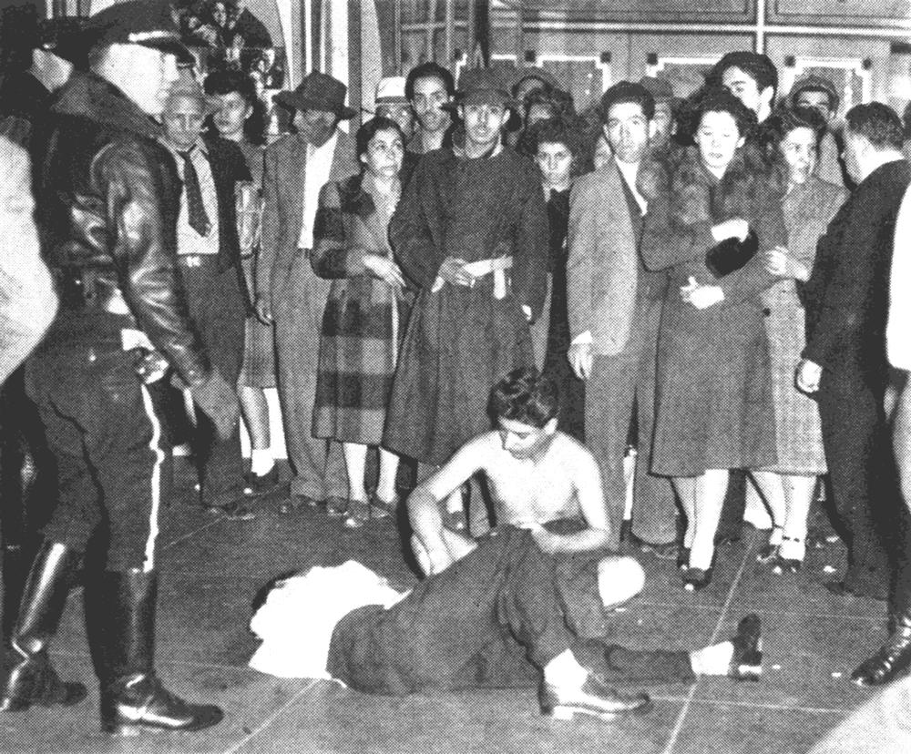

Slide 8
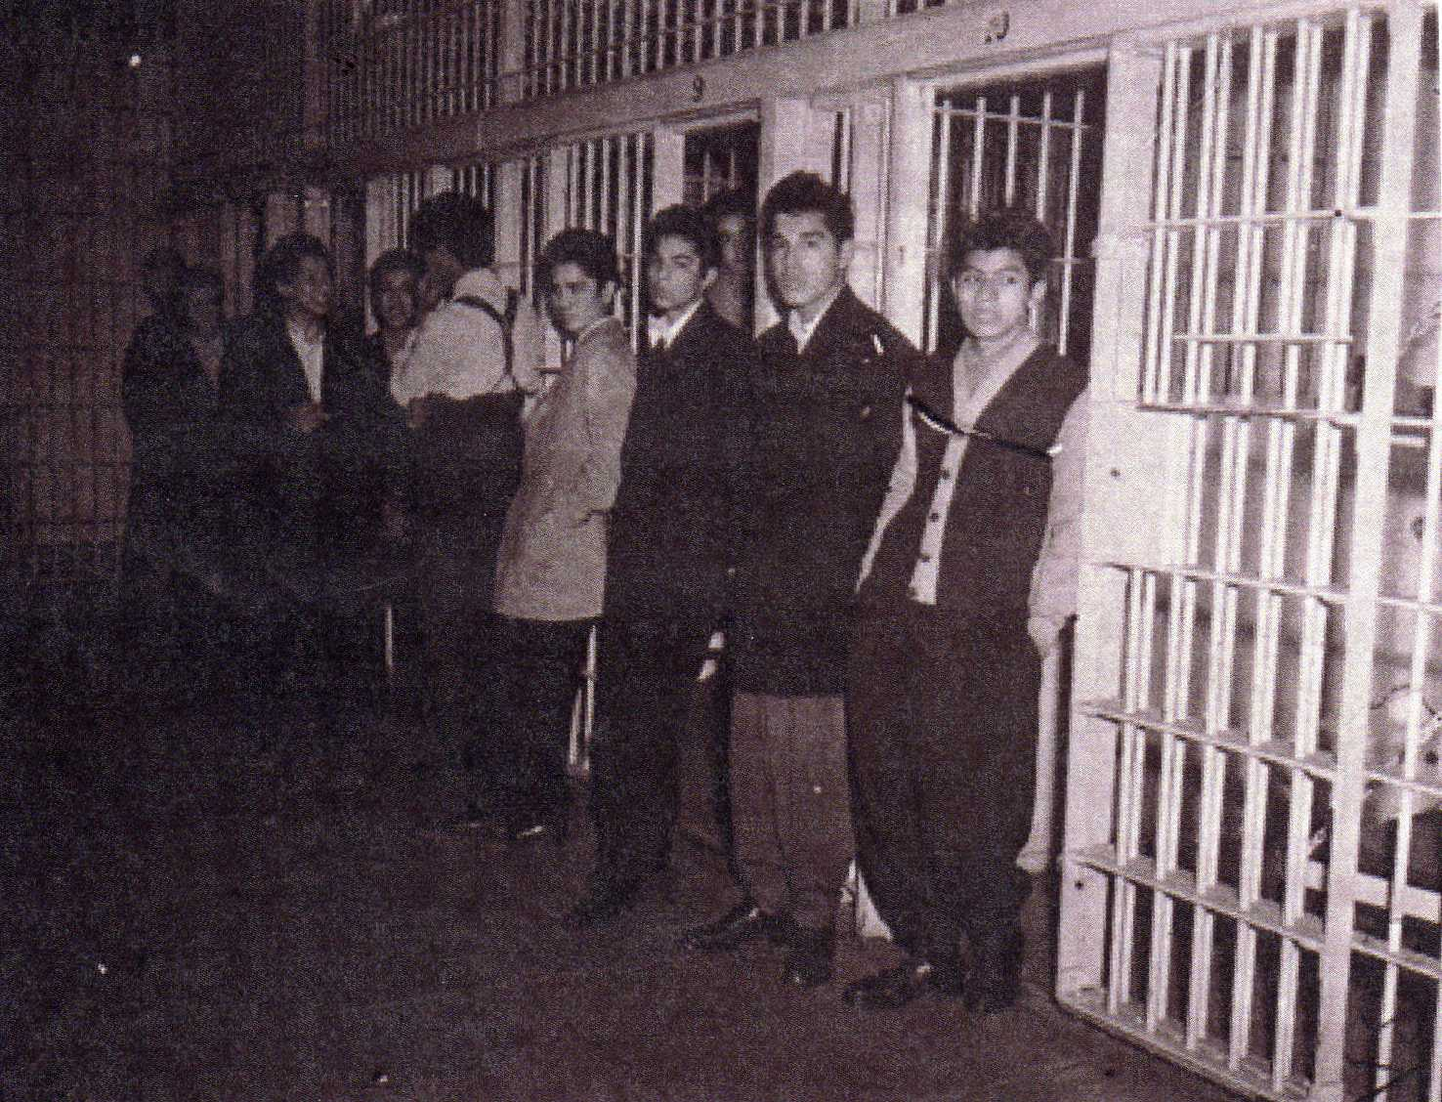

Slide 9
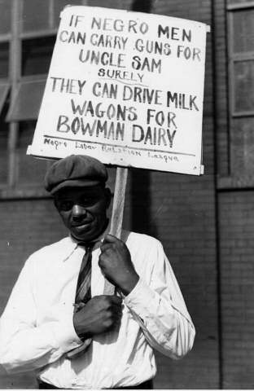
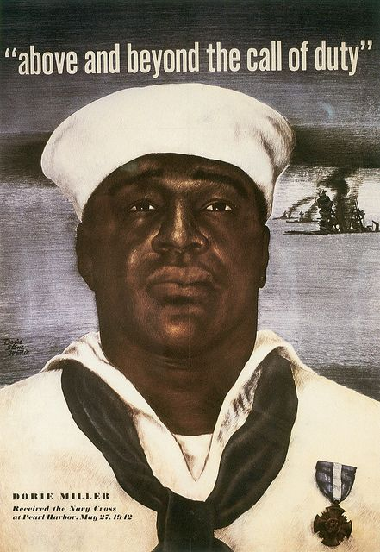
How are these images different in their
depiction of African Americans?

Slide 10
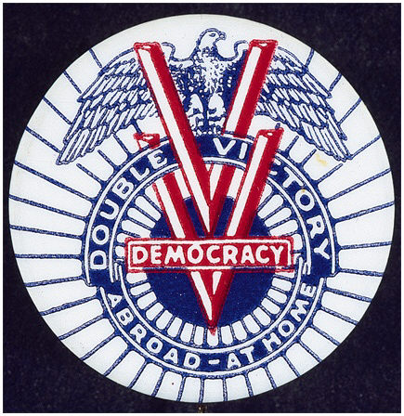
Double V Campaign
Double V Campaign: Victory over fascism abroad, and victory over discrimination at home.
Large numbers of AA migrate to industrial cities; leads to race riots in major cities
(Sound familiar?)

Slide 11
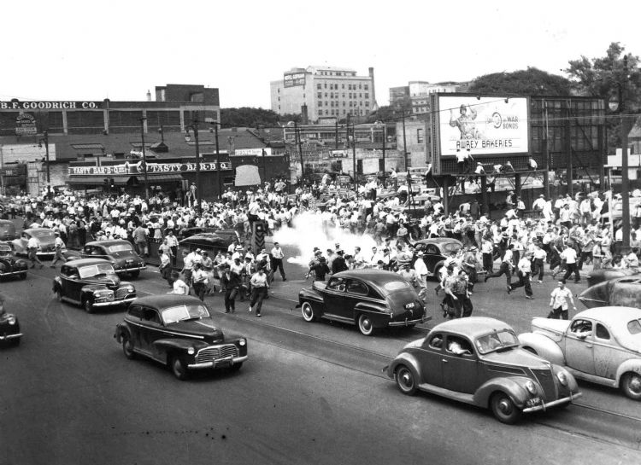
Detroit Race Riot (1943)

Slide 12
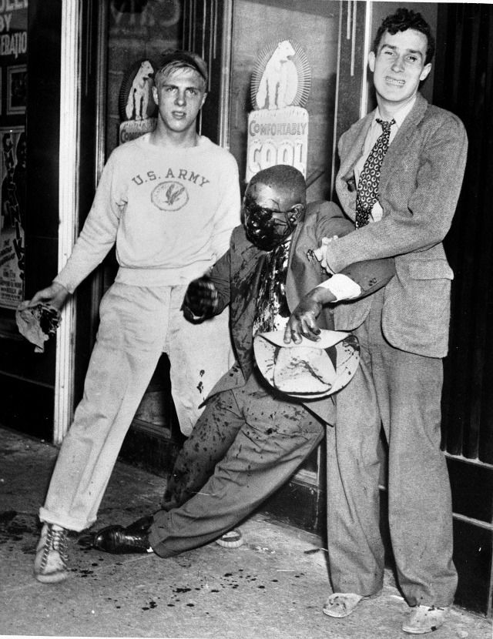
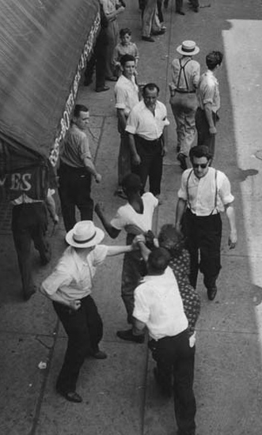

Slide 13
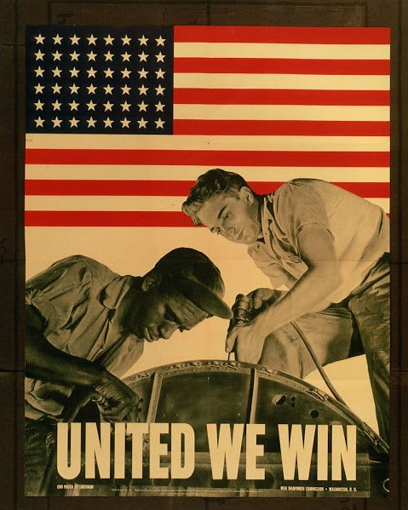
Executive Order 8802
March on Washington Movement by A. Philip Randolph: Protest over discrimination in hiring at munitions factories
Executive Order 8802: Eliminated discrimination in defense industries or government because of race

Slide 14
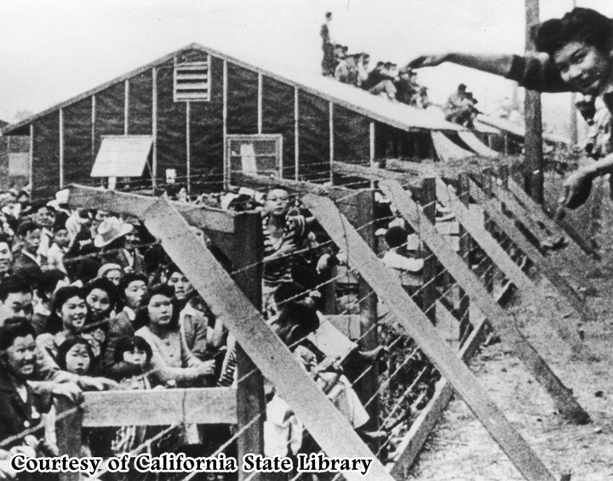
Japanese Internment

Slide 15
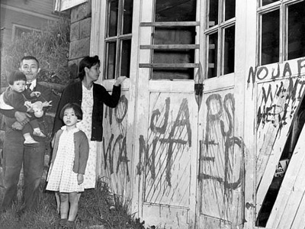
Japanese Internment
Fears following Pearl Harbor that Japanese-Americans would aid the enemy
War Department demanded “enemy nationals” be removed from the West Coast
~120,000 Japanese-Americans living in California
Why do you think only
Japanese were interned?

Slide 17
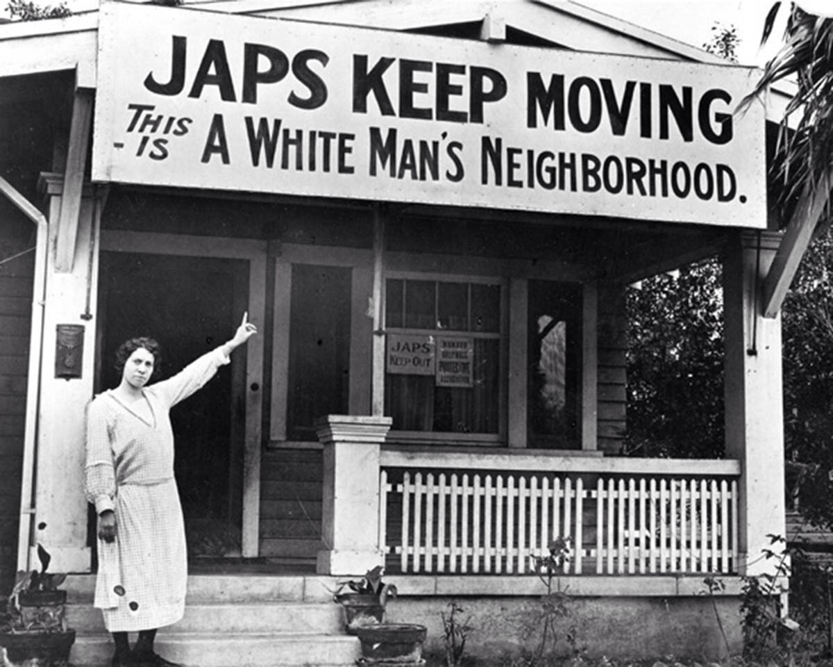
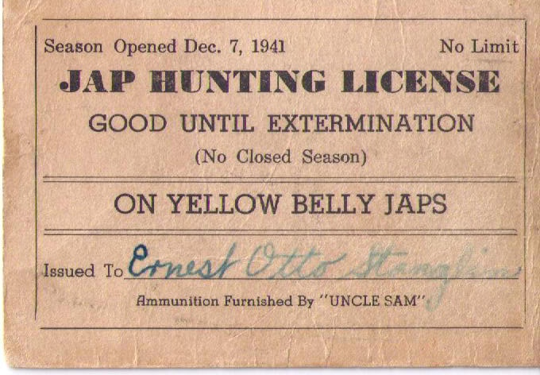

Slide 18
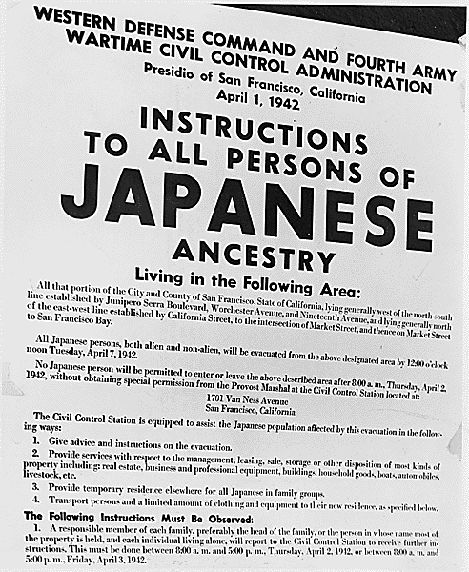
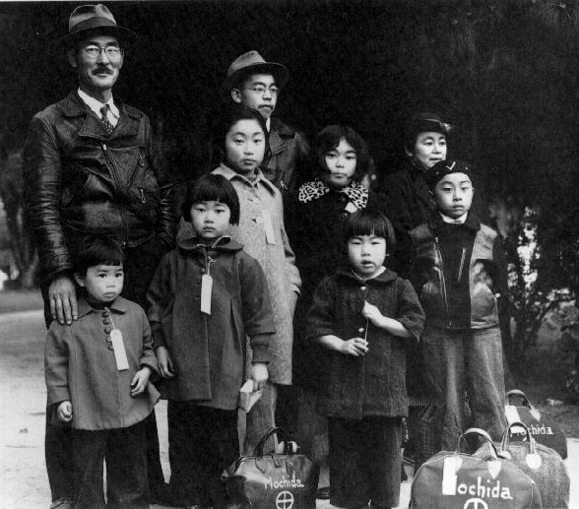
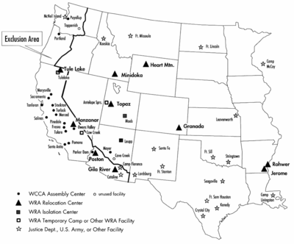
Executive Order 9066
Executive Order 9066: Provided for the removal of enemy nationals from military areas – i.e. internment those of Japanese heritage
About 110,000 sent to “War Relocation Camps” that were located away from the coast
62% were American citizens

Slide 19
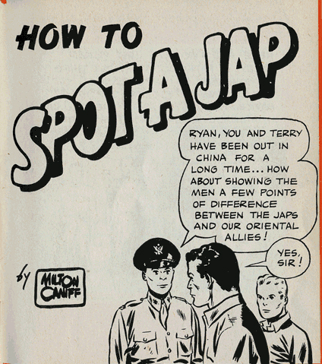

Slide 20
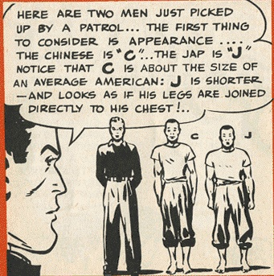

Slide 21
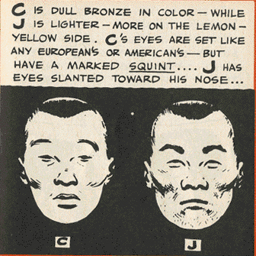

Slide 22
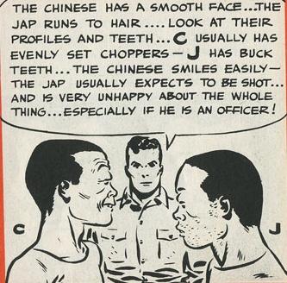

Slide 23
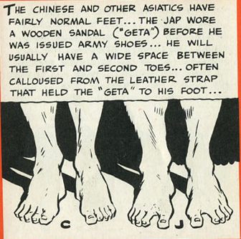

Slide 24
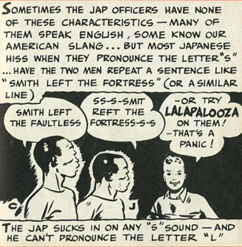

Slide 25
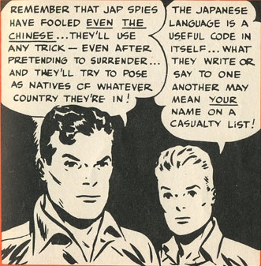

Slide 26
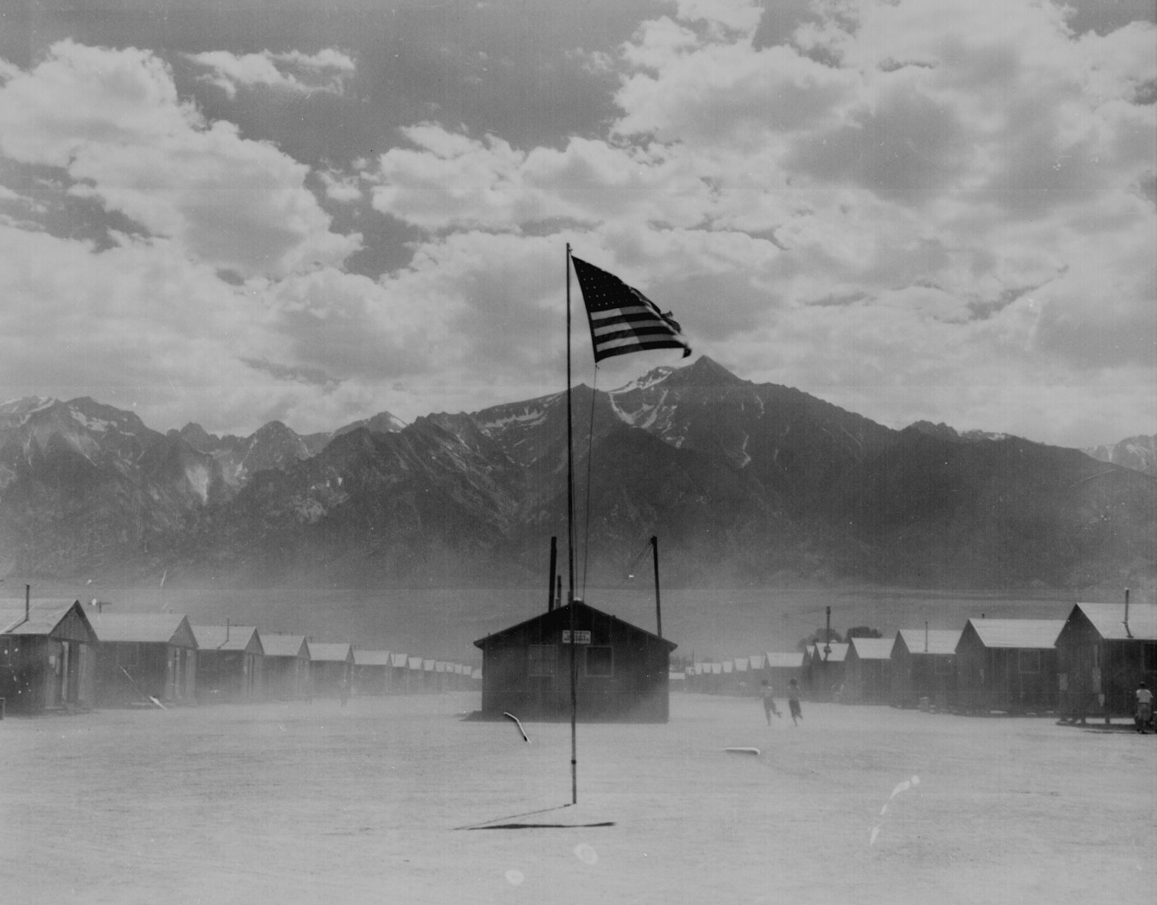
Japanese Internment
Camps built from old army barracks and tents, or built by internees themselves
Patrolled by armed guards
Not prepared for weather in new locations
Businesses arose to meet community’s needs (e.g. barber shops, schools, etc.)
Manzanar – largest and most well-known

Slide 27
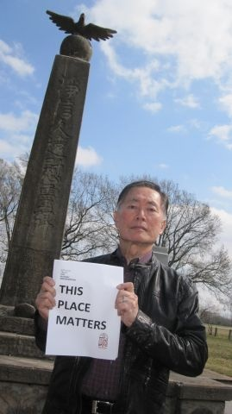
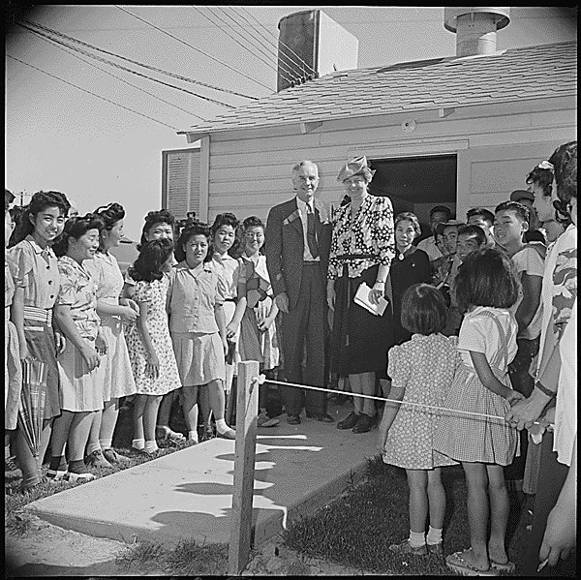
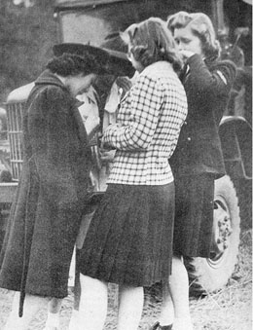
Fighting Back Against Internment

Slide 28
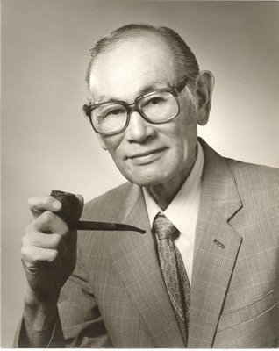
Korematsu v. United States
Question
Did the President and Congress go beyond their war powers by restricting the rights of Americans of Japanese descent? (14th Amendment)
Decision: 6-3 vote in favor of the U.S.
Used the “clear and present danger” doctrine to support their decision

Slide 29
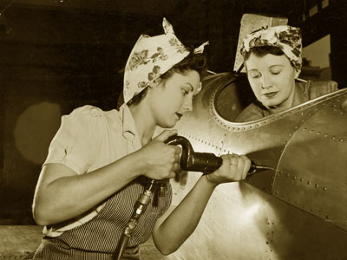
Women on the Home Front

Slide 30
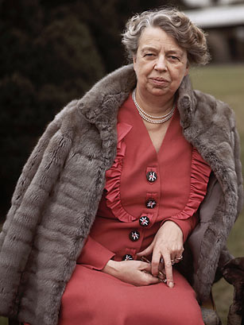
Eleanor Roosevelt
Model for all future First Ladies
Politically active in her own right
Had a personal cause independent of her husband’s policies
Used her position to further political causes
Feminist
Civil Rights activist
Human Rights activist
Notes:
Press conferences only for female journalists
Marian Anderson, Tuskegee Airmen, Internment
UN Declaration of Human Rights

Slide 31
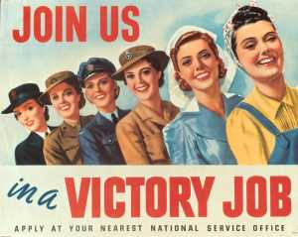

Slide 32
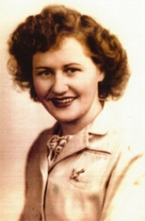
Rosie the Riveter
In 1944, unemployment hit an all time low of 1.2% (as opposed to 25% a decade earlier).
Women began working in factories during the war, producing munitions and war supplies
Rosie the Riveter became a cultural icon
Based on Rose Will Monroe

Slide 33
Rosie the Riveter

Slide 34
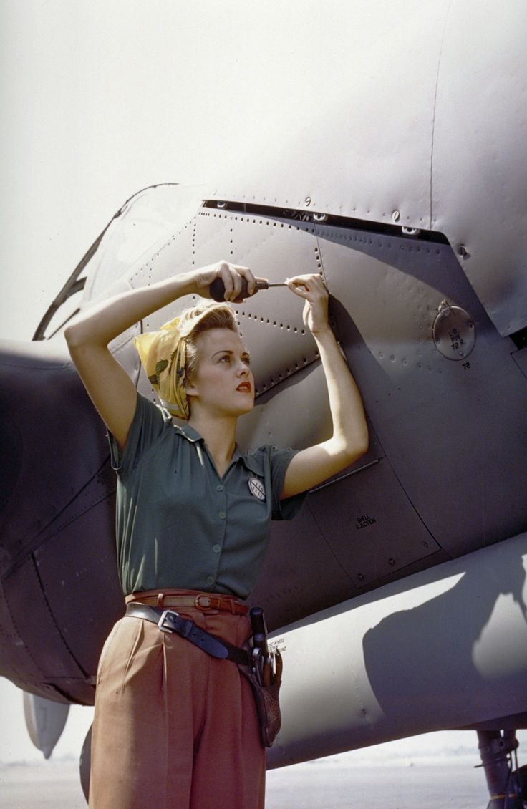
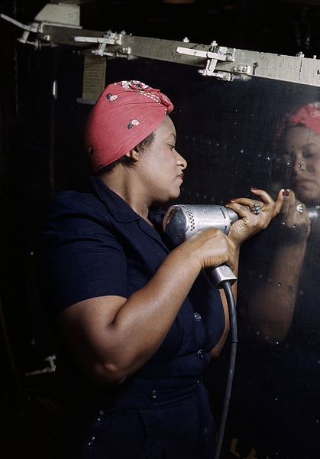
Maintaining Femininity

Slide 35
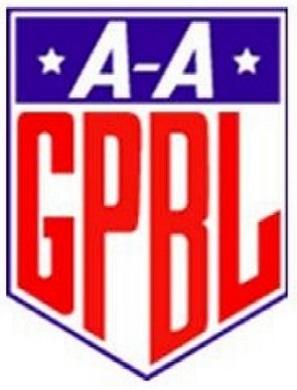
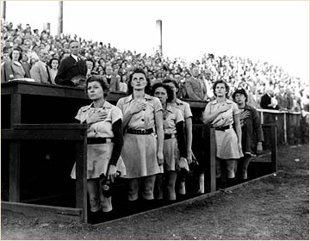
All-American Girls Professional Baseball League (AAGPBL)
Baseball was America’s past time, but the war would not stop young players from being drafted
An all-female league was developed to continue the season

Slide 36
Bell Ringer
Which advertising tactic is most effective in convincing you to buy an item? Explain your answer.
Bright, colorful advertisements
Ads that touch your emotions
Use of celebrity endorsements
Ads that make you feel special or important
Ads that use comedy to catch your attention

Slide 37
WWII Propaganda
Getting America behind the war
The purpose of propaganda is to convince an individual or group to believe or do something they may not already believe in or do.

Slide 38
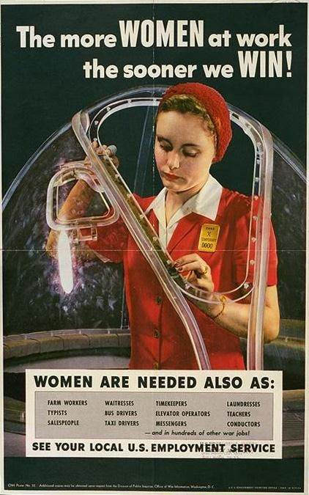
WWII Propaganda
Front lines and home front linked through posters, radio, etc.
It was the job of every American to contribute to the war effort
Often resorted to extreme racial and ethnic caricatures of the enemy
Office of War Information: Coordinated the release of war news; used posters and radio broadcasts to promote patriotism

Slide 39
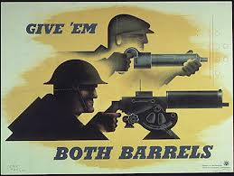
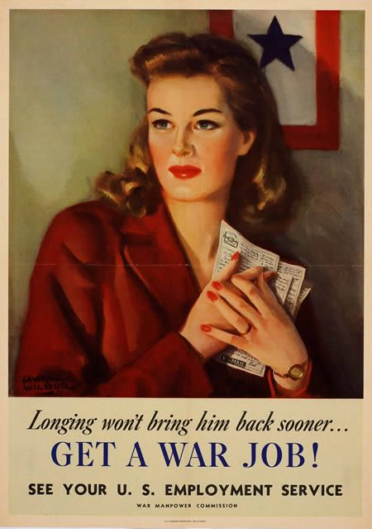
Link front lines to home front

Slide 40
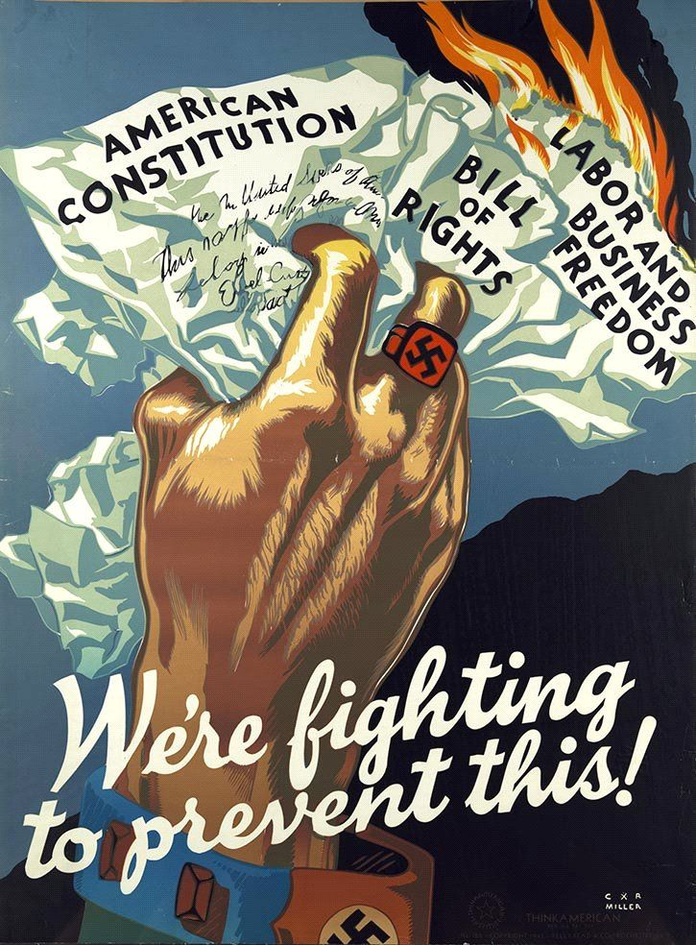
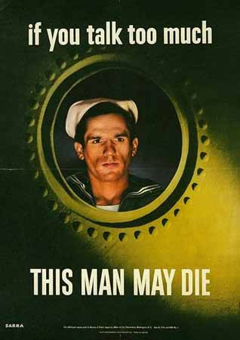
Protect American secrets
Protect American traditions

Slide 41
Ensure support of war
Reduce Fear

Slide 42
Dr. Seuss Goes to War

Slide 43
Dr. Seuss Goes to War
Because of the fame of his children's books and because his political cartoons have remained largely unknown, we do not think of Dr. Seuss as a political cartoonist. But for two years, 1941-1943, he was the chief editorial cartoonist for the New York newspaper PM (1940-1948), for which he drew over 400 editorial cartoons.

Slide 48
Manufacturing and Labor
The Savior of the U.S. Economy

Slide 49
Increased industrial output
2x Germany, 5x Japan
Helped turn the tide in favor of an Allied victory
Women joining the workforce had a large impact on maintaining high levels of production
Early mobilization before the war
E.g. Lend-Lease
Economic
Survival

Slide 50
Reconstruction Finance Corporation (RFC): Made loans to companies to help them with the cost of converting to war production.
War Production Board (WPB): Set priorities and production goals and to control the distribution of raw materials and supplies.

Slide 51
Ford’s B-24 Bomber Plant
Notes:
Easy transfer from cars to planes

Slide 52
Unionization
Congress of Industrial Organization (CIO - 1935): A federation of unions that organized workers in industrial unions
Open to African Americans
“An injury to one is an injury to all”
Unions grow during the war
Competition for membership between CIO and AFL
Wartime no-strike pledge
Government offered arbitration for wages and new contract terms

Slide 53
Paying for War
Production, Payment, and Propaganda

Slide 54
Income Taxes
Prior to World War II, few outside the federal government paid income tax
“Victory Tax” (1942)
$ withheld from paychecks
Lowered the minimum income to pay taxes, and reduced personal exemptions and deductions
By 1944, 90% of those employed were paying federal income taxes (compared to 10% in 1940)

Slide 55
Buying Bonds
War Bonds: Certificates issued by the U.S. government to finance war expenditures
Citizens buy bonds now a Government uses $ now a Government pays back with interest later
Wildly popular - 85 million bonds purchased = $185 billion
Stamps also could be purchased, starting at 10 cents each, to save toward the bond.

Slide 56
Paying for War
Bond rallies were held to increase bond sales
Famous celebrities and Hollywood film stars
Encouraged to put at least 10% of every paycheck into Bonds
“Minuteman Flag”

Slide 57
Rationing in WWII

Slide 58
Rationing
Office of Price Administration (OPA): Government organization in charge of regulating prices and rationing of consumer goods during the war.
Blue chips: Processed foods
Red chips: Meats
Green chips: Other goods
Some items were no longer made due to rationing
Ration stamps were valid only for a set period to prevent hoarding
Notes:
ration coupons to purchase typewriters, coffee, sugar, gasoline, bicycles, clothing, fuel oil, silk, nylon, stoves, shoes, meat, cheese, butter, lard, margarine, canned foods, dried fruits, jam
Some items—like new automobiles and appliances were no longer made.

Slide 59
Cooking without Sugar!
Homemakers were faced with the challenge of feeding their families on greatly reduced portions of food, resulting in some interesting recipes.
Notes:
Grilled pigeon

Slide 60
Rationing
Victory Gardens: private or public gardens in which food was grown to avoid purchasing foodstuffs that could be used in the war effort.
Produced up to 40% of all vegetable produce
Were planted anywhere there was room
Scrap drives were organized to recycle such products as rubber, tin, waste kitchen fats, newspaper, lumber, steel, etc.
Encouraged to raise thermostats, use less coal, etc.

Slide 61
Rationing
Fabric is rationed during the war to be used for soldiers’ uniforms, tents, etc.
Clothing drives
Mending circles
Use it up, Wear it out, Make it do, or Do without

Slide 62
Necessity being the mother
of invention, women began
finding substitutes for
rationed goods like cloth,
nylon, leather, and rubber.

Slide 64
Military Support:
All Day, Every Day, in Every Way

Slide 65
“V for Victory”

Slide 66
Blackout!
Mainly on East coast of U.S.
Preventing city lights from revealing Allied supply ships, making them easy targets for German U-boats.
Heavy drapes
Turn off lights
Street lights and headlights

Slide 67
Blue Star Banners
The Blue Star Banner was created in World War I, but hit its height of popularity during WWII. The flag signifies with a blue star the number of family members currently serving in war. Gold stars represent those that have died in battle.

Slide 68
The USO
The United Service Organization (USO): A private, nonprofit organization that provides morale and recreational services to members of the U.S. military.
Intends to boost morale of soldiers
Most popular during WWII
Camp Shows with the biggest names in Hollywood
Bob Hope
Notes:
Hit its peak during WWII with nearly 1.5 million Americans having volunteered their services in some way
The organization became particularly famous for its live performances called Camp Shows, through which the entertainment industry helped boost the morale of its servicemen and women.
From 1941 to 1947, the USO presented more than 400,000 performances, featuring entertainers such as Bing Crosby, Judy Garland, Humphrey Bogart, Frank Sinatra, The Marx Brothers, James Cagney, James Stewart, The Rockettes, Fred Astaire, The Andrews Sisters, Lucille Ball, and most famously, Bob Hope.

Slide 69
Boogie Woogie Bugle Boy - The Andrews Sisters

Slide 70
WWII Popular Culture

Slide 71
America’s Past Time

Slide 72
The Movies Go To War
The OWI and Hollywood made hundreds of war movies that reinforced patriotic ideals and reminded Americans who the heroes and who the villains were.
The OWI’s Bureau of Motion Pictures had to approve every film before they could be exported.
Studios encouraged their stars (such as Clark Gable and James Stewart) to enlist.
Warner Bros. and Disney

Slide 73
Movies

Slide 74
Swing Dancing!

