Slide 1
We’re Not Gonna Take It!
Social Upheaval in the 1960s and 1970s

Slide 2
Student Voices
The Free Speech Movement

Slide 3
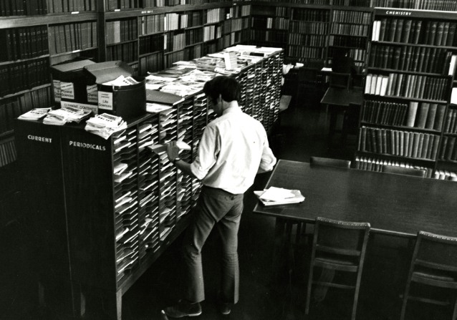
College Life
Dramatic increase in colleges during the 1950s and 1960s
  Five of the UC schools were established during this time period: Riverside, Davis, San Diego, Irvine, and Santa Cruz
College life empowered young people with a sense of freedom and independence
Students began forming groups to protest a variety of issues, most passionately, the Vietnam War.

Slide 4
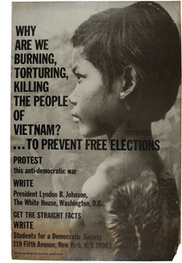
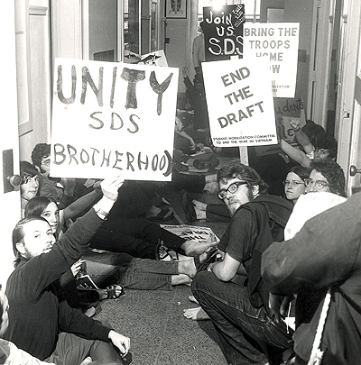
Students for a Democratic Society
Students for a Democratic Society (SDS) formed on campuses across the country
Encouraged people to protest against the following: Vietnam War, poverty, racism, nuclear power and weapons, police brutality, and big corporations influencing government.

Slide 5
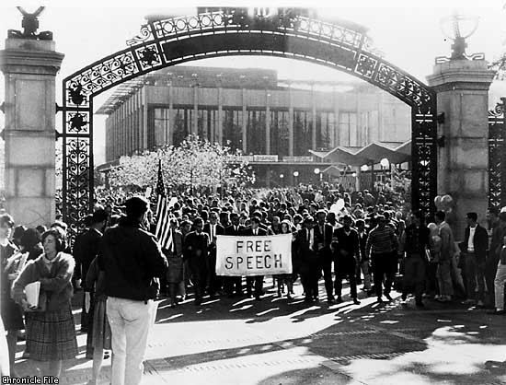
Free Speech Movement
Began at U.C. Berkeley in 1964 when officials restricted students’ rights to distribute political literature.
Administrators enforced unfair rules.
Students used sit-ins to protest .
Governor Pat Brown had over 700 protestors arrested.
Soon spread across the country, protesting university policies, and later the Vietnam War.

Slide 6
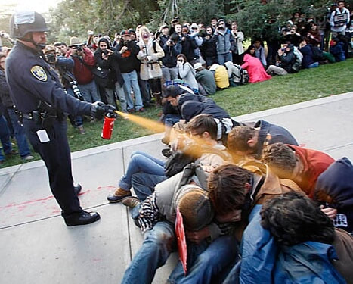
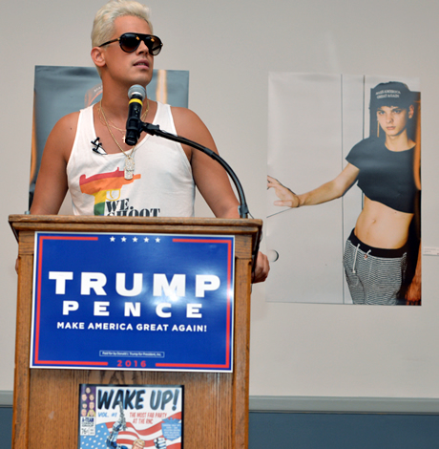
Modern-Day
November 2011, Occupy movement → tuition hikes and complaints against UC administration for highly publicized raises and furloughs of lower-ranking workers.
Milo Yiannopoulos
Notes:
“I just want to burn it down,” Yiannopoulos said in an interview last month with CNN. “I am speaking on college campuses because education … is really what matters. It’s a crucible where these bad ideas are formed. Bad ideas like … progressive social justice, feminists, Black Lives Matter … that I think is so cancerous and toxic to free expression.”
This professional provocateur, who was banned on Twitter after his harassment last summer of “Saturday Night Live” star Leslie Jones, has been making a name for himself with his “Dangerous Faggot” bus tour. In campus appearances across the nation the openly gay Yiannopoulos has made disparaging remarks about Muslims, minority students, members of the transgender community and other groups – all in the name of free speech and the fight against political correctness.

Slide 7
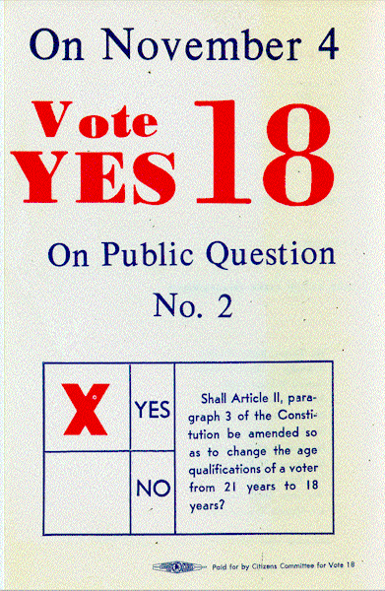
26th Amendment
26th Amendment: Changes the voting age from 21 to 18 years old.
“Old enough to fight, old enough to vote!” was the rallying cry for many young people in support of the Amendment.

Slide 8
Tune in, turn on, and check out!
The Counterculture

Slide 9
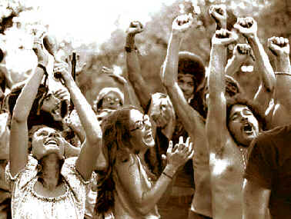
The Counterculture
Counterculture: A group whose values and behavior deviate from those of mainstream society.
Reaction to the conservatism and conformity of the 1950s.
Most were young, and from conservative middle-class families.
Came in conflict over the war in Vietnam, race relations, human sexuality, women's rights, traditional modes of authority, experimentation with drugs, and differing interpretations of the American Dream.
Somewhat inspired by the Beat Generation of the 1950s.

Slide 10
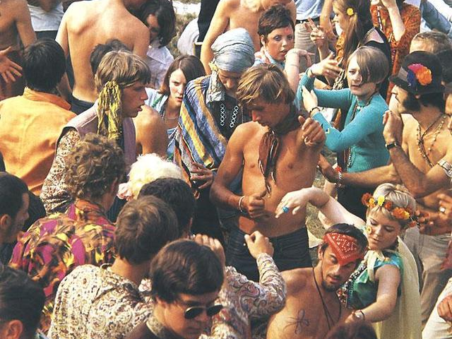
Hippies
Hippies first introduced at the Human Be-In in 1967 at Golden Gate Park, SF.
Believed in a utopian ideal: a society that was freer, closer to nature, full of love, empathy, tolerance, and cooperation.
Adopted new styles of dress, experimented with psychedelic drugs, lived communally, adopted the policy of “free love”, and developed a vibrant music scene.

Slide 11
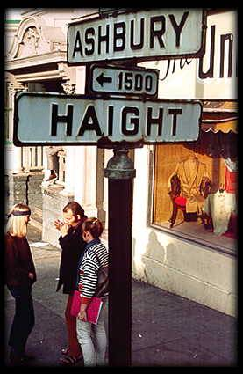
San Francisco and the Summer of Love
San Francisco (Be Sure to Wear Flowers in Your Hair): Was written and released in 1967 to promote the Monterey Pop Festival
Drew over 100,000 young people to San Francisco for the “Summer of Love.”
  Haight-Ashbury

Slide 12
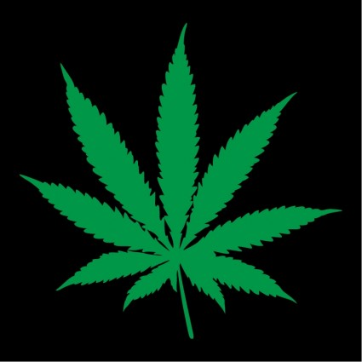
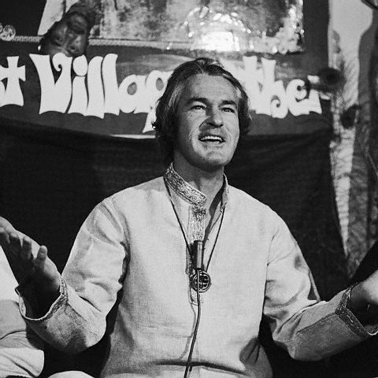
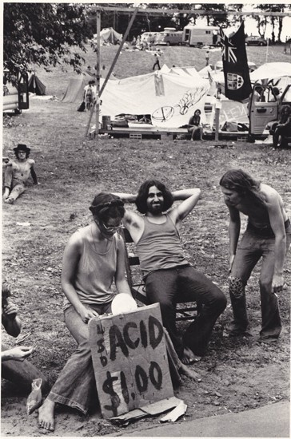
Drug Culture
Hippies used hallucinogenic drugs to raise consciousness and “expand their minds”
  Marijuana, LSD, “Magic Mushrooms,” and mescaline
LSD first developed by the federal government as a potential mind control weapon in the Cold War
Dr. Timothy Leary: Proponent of LSD; conducted experiments using LSD in psychotherapy at Harvard University.
  “Tune in, turn on, drop out” as a motto for the hippie culture.
Tune In, Turn On, Drop Out

Slide 13
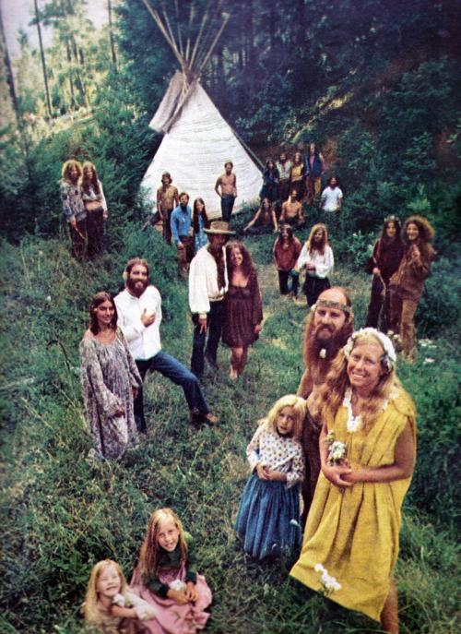
Communes
Utopian communities looking to break from traditional society.
The Farm was the most well-known hippie commune, created by 300 San Francisco hippies in rural Tennessee.
Still a functioning commune, based on principles of nonviolence and respect for the Earth.
Jonestown

Slide 14
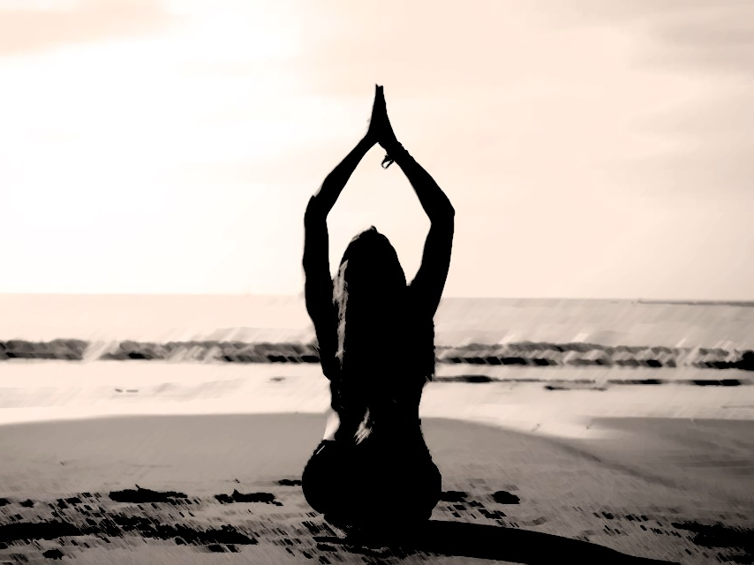
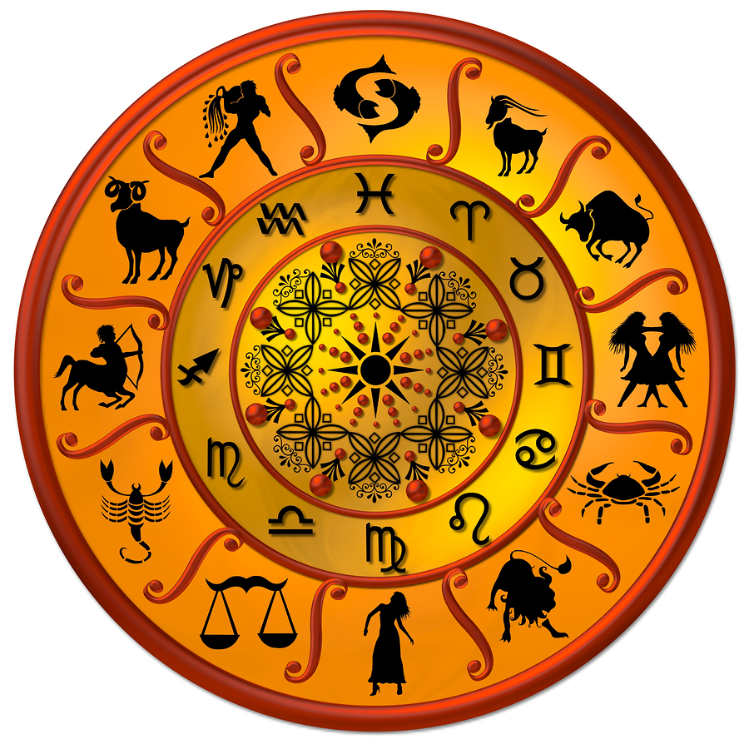
Religion
Many members of the counterculture embraced spirituality and alternative religions
  Astrology
  Eastern religions
  New forms of Christianity
Religious groups centered around authoritarian leaders
  Parental figure and extended families
  Cult-like

Slide 15
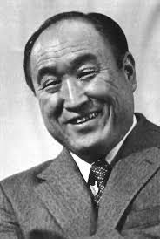
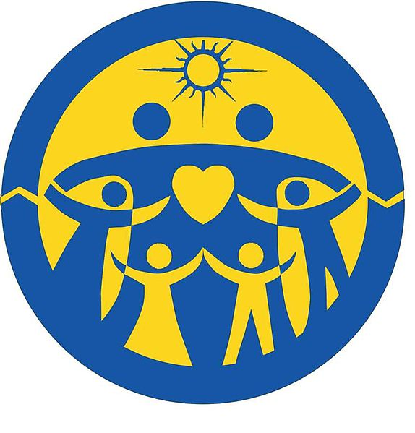
RELIGION
Unification Church:
Founded by Rev. Sun Myung Moon
Members called “Moonies”
Consider Moon to be the new Messiah and seek to create Heaven on Earth through world peace

Slide 16
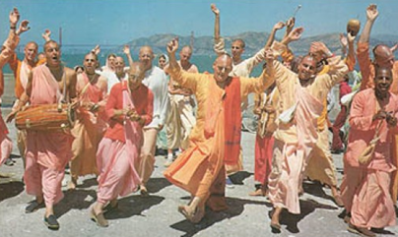
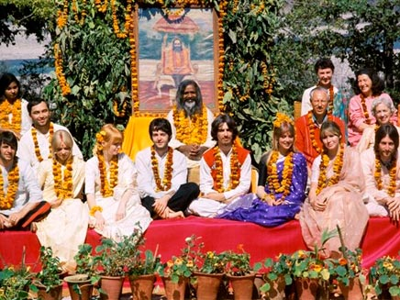
Religion
The Hare Krishna movement:
Branch of Hinduism; worship the god Krishna
Repeat the mantra Hare Krishna
First converts were hippies in New York City
  Shaved their heads and adopted Indian clothing as signs of membership.
  Chant and dance in public (a practice called kirtan) and sold religious texts in airports.

Slide 17
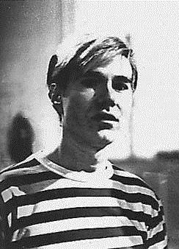
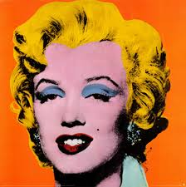
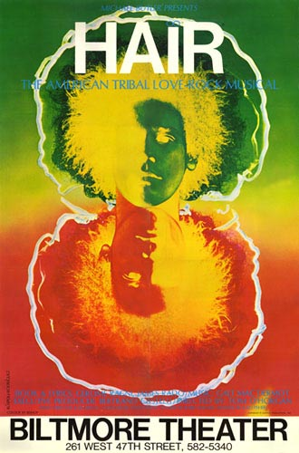
Media and Art
Underground newspapers and magazines; e.g. Rolling Stone
Counterculture art was highly influenced by Dada
  Avant-garde and Anti-Art genres.
  Andy Warhol and Pop Art
Hair - The American Tribal Love-Rock Musical: First musical to use rock and roll music; exemplifies the hippie counterculture anti-war movement 1960s.

Slide 18
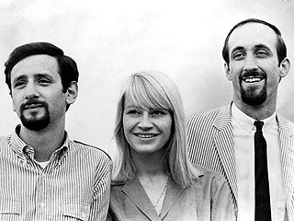
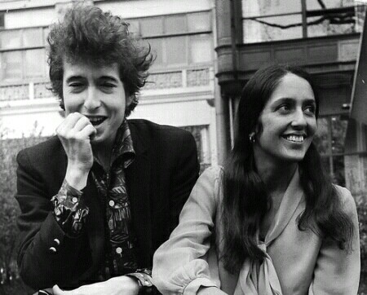
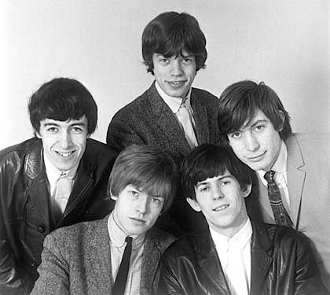
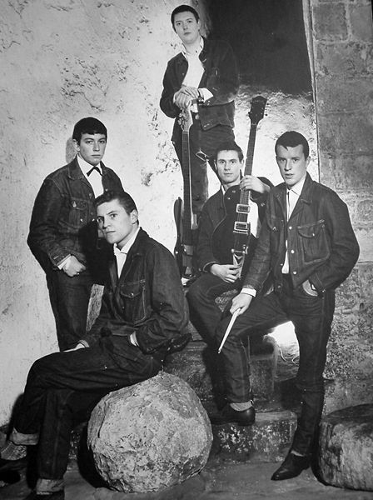
Music
Folk Music revival: Highly involved in the civil rights and free speech movements
  Bob Dylan, Joan Baez, and Peter, Paul & Mary
The British Invasion: Influenced by the folk music scene and early rock and roll
  The Rolling Stones, The Animals, The Who, Herman’s Hermits, Manfred Mann

Slide 19
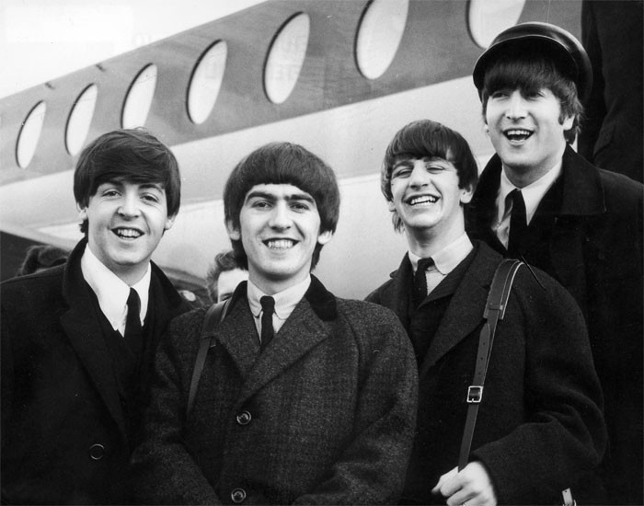
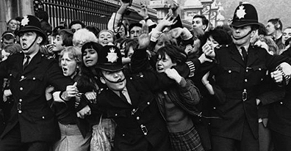
Beatlemania!
The Beatles came to the United States on February 7, 1964 to perform on the Ed Sullivan Show. The screams of the audience made much of their performance unable to be heard.

Slide 20
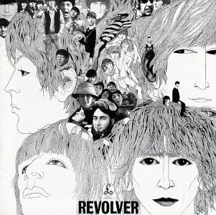
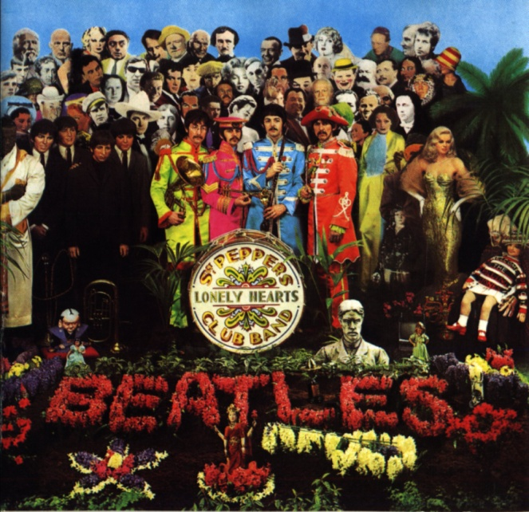
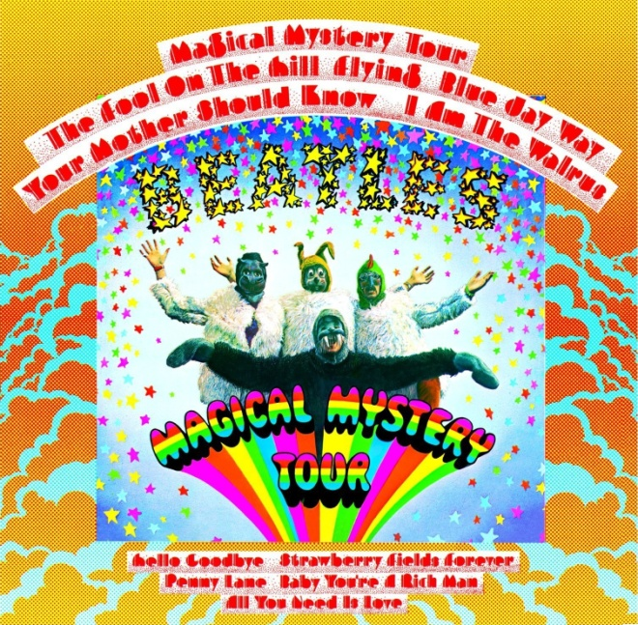
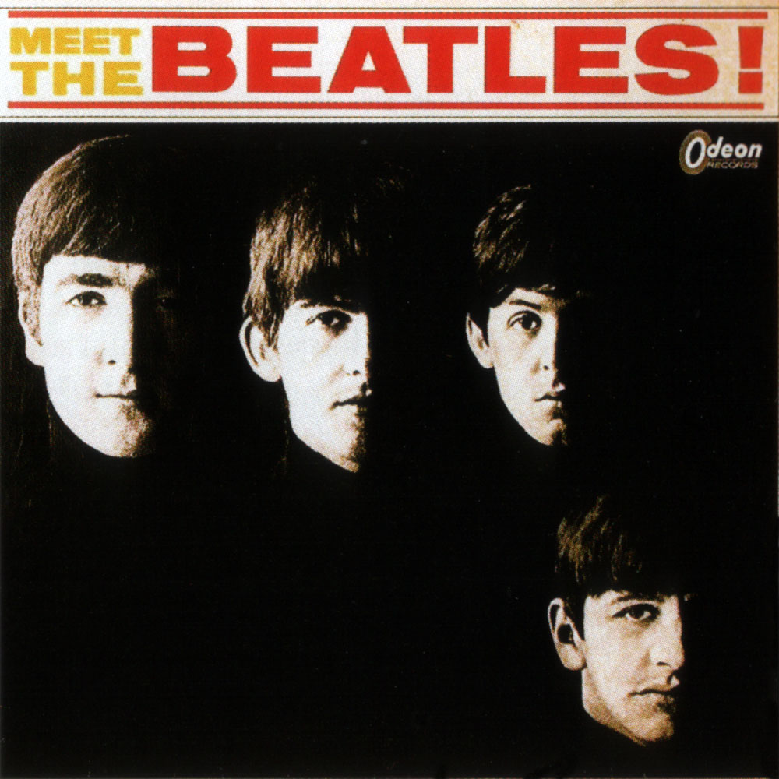
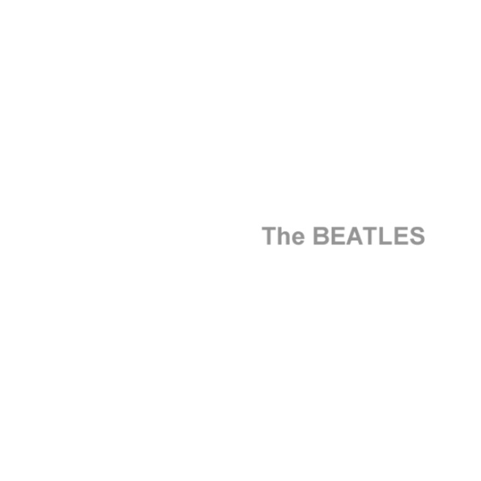
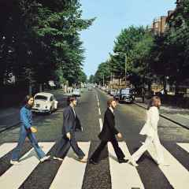
The Fab Four Evolves

Slide 21
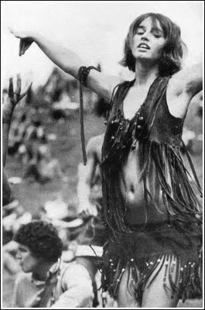
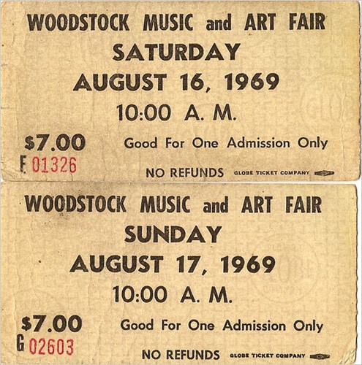
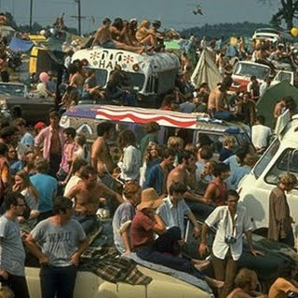
Woodstock 1969
Woodstock was a music and art festival held from August 15th-18th in New York
32 of the best known musicians played in front of over a half a million people.
The behaviors exemplified the counterculture movement

Slide 22
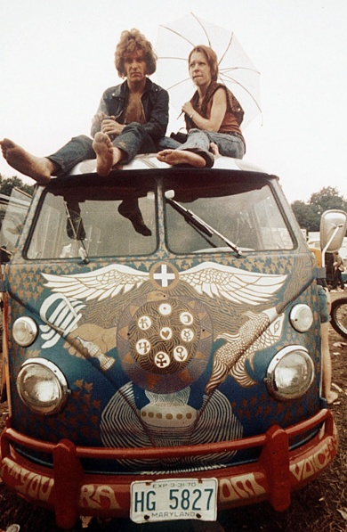
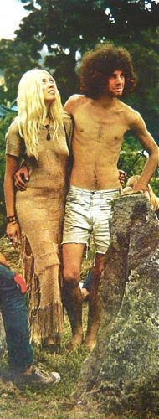
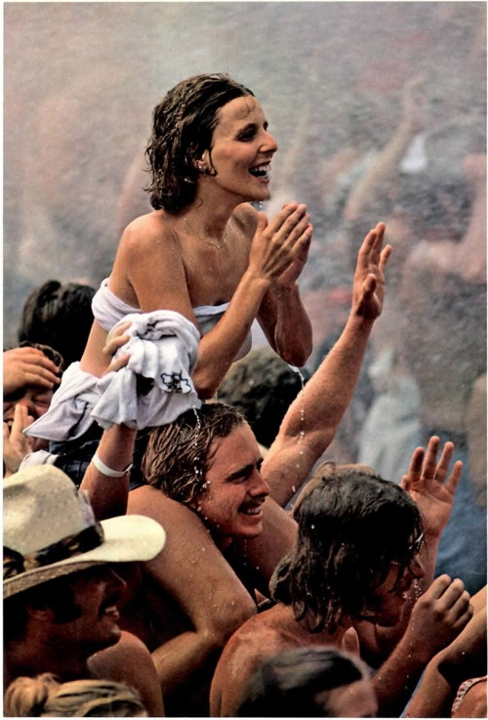
Woodstock

Slide 23
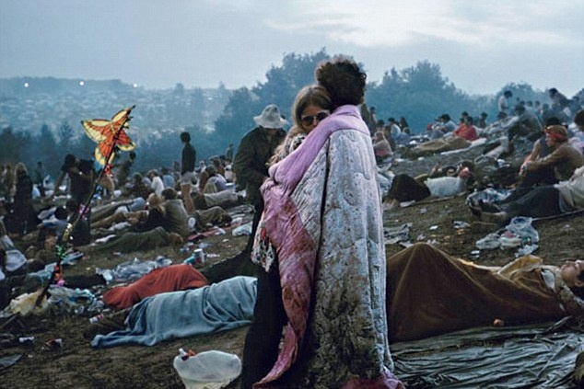
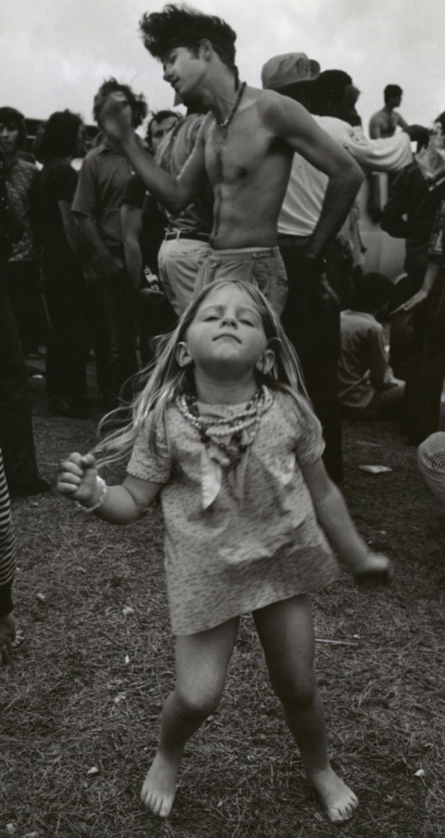
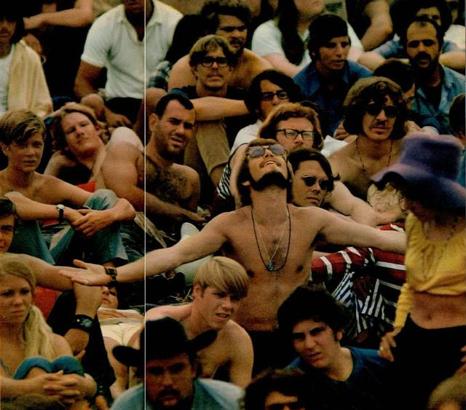
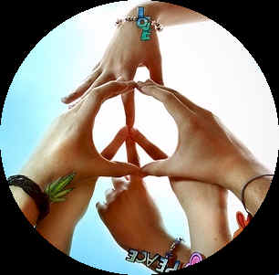

Slide 24
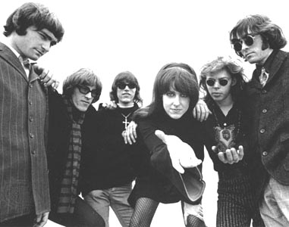
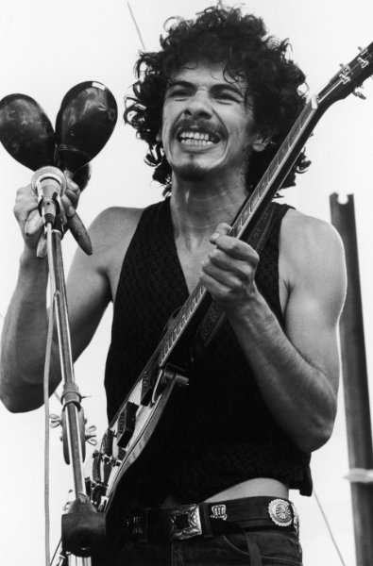
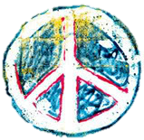
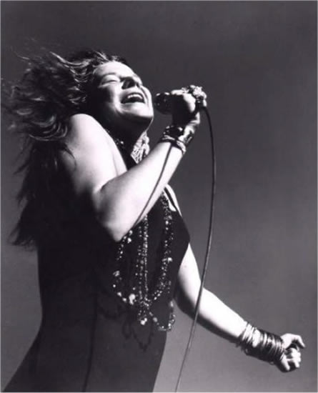
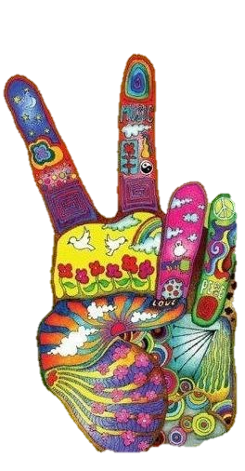

Jefferson Airplane, Joan Baez, Santana, Janis Joplin, The Grateful Dead, CCR, Sly & the Family Stone, The Who, Blood Sweat and Tears, Country Joe and the Fish, Crosby Stills Nash & Young…

Slide 25

Jimi Hendrix
Notes:
https://faroutmagazine.co.uk/jimi-hendrix-national-anthem-woodstock-explanation-dick-cavett/

Slide 26



The Death of Woodstock
Woodstock '94 was a music festival organized in order to commemorate the 25th anniversary of the original Woodstock Festival of 1969.
  “Mudstock”
Woodstock ’99 attempted to emulate the original Woodstock Festival of 1969.
  Ended with violence and rioting

Slide 27

Forever 27 Club

Slide 28



Death of the Counterculture
The counterculture began to disappear in the early 1970s.
Drug use declines
  No longer exciting
  Addiction and deaths
Charles Manson and the Manson Family:
  Helter Skelter: His interpretation of the Beatles hit that outlined an impending race war
  Ordered the murder of actress Sharon Tate and two friends at their home in the Hollywood Hills.
Altamont Speedway Free Festival: Intended to be “Woodstock West”
  Marred by four deaths, as the Hell’s Angels were used as a security force.
The largest reason for the decline of the counterculture was the inclusion of many counterculture ideals into mainstream society.

Slide 29
Civil Rights Marches Forward… and Backward
Creating Equality, Raising Awareness, and Infringing on Civil Liberties

Slide 30



Miranda v. Arizona
Ernesto Miranda was questioned by police after being arrested for kidnapping and rape
Was unaware of rights that protected him from this type of questioning, or that he could have an attorney
SC determines this violated his 5th Amendment rights against self-incrimination
Creation of the Miranda Warning

Slide 31

Equality Creates Inequality
Affirmative Action: Policies that take factors including "race, color, religion, sex, or national origin" into consideration in order to benefit an underrepresented group "in areas of employment, education, and business”
UC Regents v. Bakke: Determined the unconstitutionality of “reverse discrimination” under the 14th Amendment
Prop 209 (1996): Abolished preferential
treatment based on race, gender, ethnicity, or
national origin
Notes:
Allan Bakke, a 33-year-old white male, after serving in Vietnam, working as an engineer for NASA, and scoring in the top 3% on his MCAT’s, applied to twelve medical schools in 1973. He was rejected by all twelve schools. He applied to UC Davis in 1973 and 1974 and was rejected both times.
What is the current legal status of affirmative action?
June 23, 2016 - The US Supreme Court upholds the Affirmative Action program by a vote of four to three with Justice Elena Kagan taking no part in the consideration. The ruling allows the limited use of affirmative action policies by schools.

Slide 32



Si Se Puede!
Cesar Chavez and Dolores Huerta co-founded the National Farm Workers Association (later the United Farm Workers union, UFW)
Their aggressive but nonviolent tactics made the farm workers' struggle a moral cause with nationwide support.
  Delano Grape Strike

Slide 33


Si Se Puede!
Large increase of Mexican immigrants to the U.S. due to less stringent immigration policies
La Raza Unida: The first political party specifically for Hispanics. During the 1970s the Party campaigned for better housing, work, and educational opportunities for Mexican-Americans.

Slide 34


Native Americans Fight Back!
Less than 1% of the population
Poorest minority group in the U.S.
Unemployment 10x higher than the national average
Indian Civil Rights Act (1968): Guaranteed reservation residents the protections of the Bill of Rights while also recognizing local reservation laws (subject to national laws, but not necessarily state laws on reservation land)

Slide 35




American Indian Movement
The American Indian Movement: Focused on spirituality, leadership, and sovereignty for Native Americans.
  Addressed poverty, housing, treaty issues, and police harassment
In October 1971 AIM gathered members from across the country to a protest in Washington, D.C. known as the "Trail of Broken Treaties."
Occupation of Wounded Knee and Alcatraz
Wounded Knee and My Lai (S)

Slide 36


I Am Woman, Hear Me Roar!
The Women’s Rights Movement

Slide 37

History of the Women’s Equality Movement
Feminism: the belief that men and women should be equal politically, economically and socially

Slide 38


The Feminine Mystique
Written by Betty Friedan in 1963:
“the problem lay buried, unspoken, for many years in the minds of American women… Each suburban wife struggled with it alone. As she made the beds, shopped for groceries…chauffeured Cub Scouts and Brownies…she was afraid to ask even of herself the silent question-’Is this all?’”
It exposed a sense of dissatisfaction that many women experienced but were reluctant to speak about openly.

Slide 39


The Women’s Movement Reawakens
Women in the 1960s:
Newspaper ads separated jobs by gender, clubs refused them membership, banks denied them credit and paid less for the same work.
Shut out of higher-paying jobs: Law, Medicine and Finance
The President’s Commission on the Status of Women: highlighted the problems of women in the workplace and helped create networks of feminist activists.

Slide 40



Fighting for Work Place Rights
1963 Equal Pay Act: Outlawed paying men more than women for the same job in most cases.
1964 Civil Rights Act, Title VII: Outlawed job discrimination by private employees on the basis of race, color, religion, national origin, and gender.
Equal Employment Opportunity Commission: Enforces laws against workplace discrimination, and files discrimination suits against employers
The Wage Gap: Women make 77¢ to every dollar men make in the U.S.
  Like working 59 days for free
  Even worse for African American (64¢) and Latina women (55¢)

Slide 41



The Time is NOW
The National Organization for Women: (NOW)
Demanded greater educational opportunities for women
Aided women in the work place
Denounced the exclusion of women from certain professions and from politics
Lashed out against the practice of paying women less than men for equal work.
By 1972 the movement had a magazine (Ms. Magazine) and 200,000 members

Slide 42





You play ball like a girl!
Title IX (1972)- prohibits federally funded schools from discriminating against girls and young women in nearly all aspects of its operations, from admissions to athletics.

Slide 43


National Changes
Roe vs. Wade: 1973 Supreme Court ruled that governments could not regulate abortion during the first three months of pregnancy, a time that was interpreted as being within a woman’s constitutional right to privacy.

Slide 44

National Changes
Equal Rights Amendment
Passed by Congress in 1972, to protect women against discrimination
Failed to be ratified; needed 38 states, 5 states short
Opposition:
Feared it would take away the right to alimony in divorce cases, single-gender colleges, or require women to register for the draft.
  Led by Phyllis Schlafly
“Equality of rights under the law shall not be denied or abridged by the United States or by any State on account of sex.”

Slide 45


The Impact of the Women’s Movement
More women in the workforce
  Two career families are much more common
  Employers offering flexible hours, on-site child care, and job-sharing
Outnumber men in colleges
  Earned almost 60% of all degrees in 2013
Sandra Day O’Connor: The first female Supreme Court Justice; served from 1981-2006
Geraldine Ferraro: The first female Vice Presidential candidate
Ferraro, Sarah Palin, Hillary Clinton, Kamala Harris
(1984), (2008), (2016*) (2020)

Slide 46

LGBT Equality Movement

Slide 47

History of the LGBT Community
LGBT (Lesbian, Gay, Bisexual, Transgender); QIA (Queer, Intersex, Asexual)
Wide variety of reactions towards LGBT individuals throughout history and cultures.
  Native Americans
  18th century Puritanism
  1920s Bohemianism
  Eugenics
  1950s Beat Generation

Slide 48
Notable LGBT’s in History
Alexander the Great
Leonardo Da Vinci
Michelangelo
Joan of Arc
Catharine the Great
James Buchanan
Walt Whitman
Emily Dickinson
Tchaikovsky
Oscar Wilde
Leonard Bernstein
Amelia Earhart (B)
J. Edgar Hoover (CD)
Liberace
Eleanor Roosevelt (B)
Marlon Brando (B)
Andy Warhol
James Dean (B)

Slide 49

The Stonewall Riots
The Stonewall Riots: Took place at the Stonewall Inn (a Greenwich Village bar), owned by the mafia, was popular with the poorest and most marginalized people in the gay community
  Police lost control after raiding the bar, and attracted a crowd that was incited to riot
  More protests the next evening, and again several nights later.
On June 28, 1970, the first Gay Pride marches took place in Los Angeles, Chicago, and New York commemorating the anniversary of the riots.

Slide 50

Gay Liberation Front
The Gay Liberation Front: urged lesbians and gay men to "come out", publicly revealing their sexuality to family, friends and colleagues as a form of activism, and to counter shame with gay pride.

Slide 51

Harvey Milk
First openly gay person to be elected to public office in California
Became most visible LGBT politician in the world
Passed a stringent gay rights ordinance that outlawed discrimination based on sexual orientation.
Assassinated by another city supervisor who had recently resigned but wanted his job back. His body was found by Diane Feinstein (one of CA’s current Senators).
“On this anniversary of Stonewall, I ask my gay sisters and brothers to make the commitment to fight. For themselves, for their freedom, for their country ... We will not win our rights by staying quietly in our closets ... We are coming out to fight the lies, the myths, the distortions. We are coming out to tell the truths about gays, for I am tired of the conspiracy of silence, so I'm going to talk about it. And I want you to talk about it. You must come out. Come out to your parents, your relatives.”

Slide 52
HIV/AIDS in America
HIV likely entered the United States through a single infected immigrant from Haiti in 1969
Late 1970s – “Gay cancer” spreads in NYC, LA, and SF
The Centers for Disease Control and Prevention (CDC) renamed the syndrome AIDS (Acquired Immune Deficiency Syndrome) in 1982.

Slide 53



Changing Views
The death of David Kirby, a gay AIDS victim, was published in Life magazine, bringing national attention to and putting a haunting face to the disease.
Ryan White was teenager from Kokomo, Indiana, contracted HIV through a contaminated blood treatment for his hemophilia
Became a national poster child for HIV/AIDS in the United States
Lived five years longer than predicted; died in April 1990, one month before his high school graduation.
Celebrities with HIV: Rock Hudson, Magic Johnson, Freddie Mercury, Robert Reed (AKA: Mike Brady), Greg Louganis

Slide 54

Tree-Huggers Unite!
Rachel Carson writes Silent Spring (1962), which exposed the poisonous effects of pesticides, e.g. DDT
Environmental Protection Agency (EPA)
Clean Air Act
Endangered Species Act

Slide 55


Meltdown!
Three Mile Island - a partial nuclear meltdown which occurred at the Three Mile Island power plant in PA.
It was the worst accident in U.S. commercial nuclear power plant history, but Carter reacted swiftly and effectively to ensure the safety of citizens, as well as create an investigative committee to prevent another accident.

Slide 56





Hug a Tree, Save the Whales, and Thank Mother Earth
Earth Day
Earth Hour
Earth Day is observed on April 22, and is celebrated in more than 192 countries every year.
Earth Day was founded by United States Senator Gaylord Nelson as an environmental teach-in first held on April 22, 1970.
Earth Hour encourages households and businesses to turn off their non-essential lights for one hour to raise awareness about the need to take action on climate change.
First took place in 2007, in Australia

