Slide 1
10.5 The homestead act of 1862
By Jonathon Richardson
Period 5

Slide 2
What is the homestead act?
Enacting on May 20th, 1862 the Homestead act provided the acceleration of settlement in the western territory. To accelerate the settlement during the Civil War, adult heads of families were granted 160 acres of surveyed government land if they did not fight for the Confederate side.
Claim to land could also be acquired after a 6-month residency and paid the government $1.25 per acre. After the Civil War, Union soldiers could deduct the time they have served from the residency requirements.

Slide 3
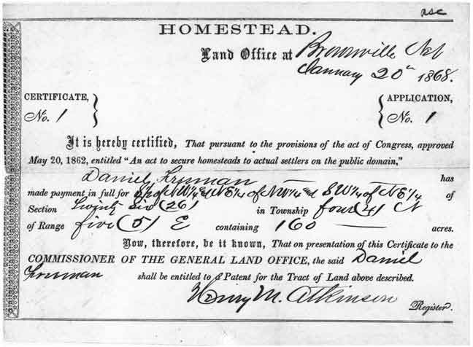

Slide 4
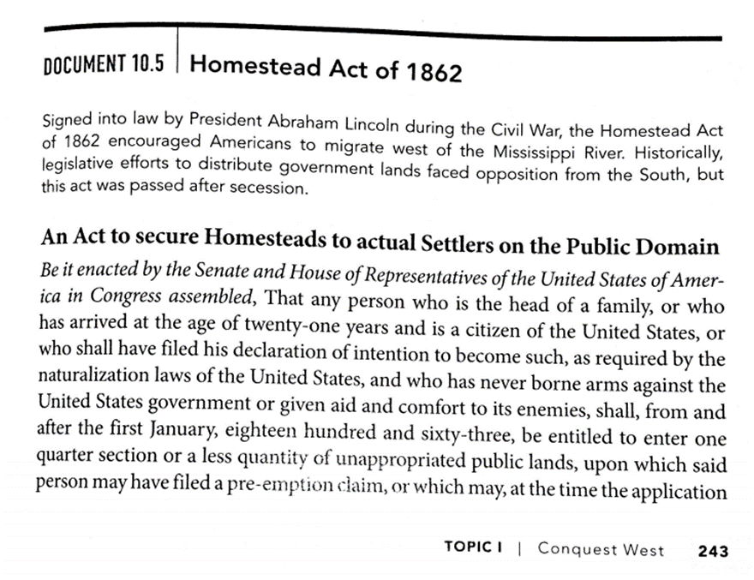
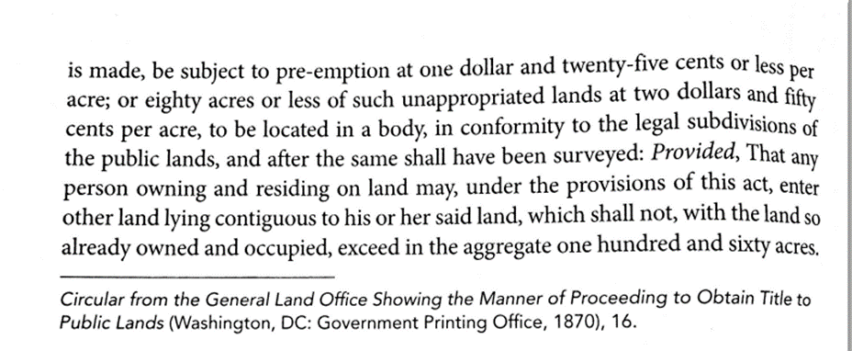
h.i.p.p.o.s

Slide 5
Key period 5 10.5 h.i.p.p.o.s
Historical Context- After the succession of the southern states and starting the Civil War, in 1862 Lincoln passed the Homestead Act for those not supporting Confederates.
Intended Audience- The intended audience of this act is anyone in America who does not fight for or supports the Confederates.
Purpose- The act was made to promote the support of the Union during the Civil War because of the benefits it brought to those who did not support the south.
Another, but important purpose of this act, was to advance settlement in the western territories for farmers, miners, speculators and many others.
Point of View- The United States Congress finds the creation of this act an important action during the civil war because it meant greater numbers in support of the war for the Union side if people got a benefit out of it.
Outside info- The 1863 Emancipation Proclamation has a similar guideline to the Homestead Act through their shared idea of what states and their people are qualified for the document’s laws.
Synthesis- Into the future in the year 1916, an amended act called the Stock-Raising Homestead Act was passed and involves the qualifications to gain 640 acres of land.

Slide 6
Questions on the act
1. When was the Homestead Act enacted?
January 1st, 1863
May 1st, 1863
May 20th, 1862
July 23rd, 1864
2. How many of acres of land would you acquire if you met the requirements
640
160
260
120
3. True or False? Soldiers after the war could deduct the payment amount from $1.25 to $1.00 per acre.
TRUE
FALSE

Slide 7
Answers to the questions
1. When was the Homestead Act enacted?
January 1st, 1863
May 1st, 1863
May 20th, 1862
July 23rd, 1864
2. How many of acres of land would you acquire if you met the requirements
640
160
260
120
3. True or False? Soldiers after the war could deduct the payment amount from $1.25 to $1.00 per acre.
TRUE
FALSE because the residency requirements were deducted, not payment.

