Slide 1
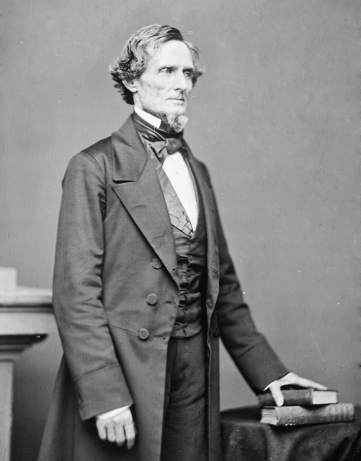
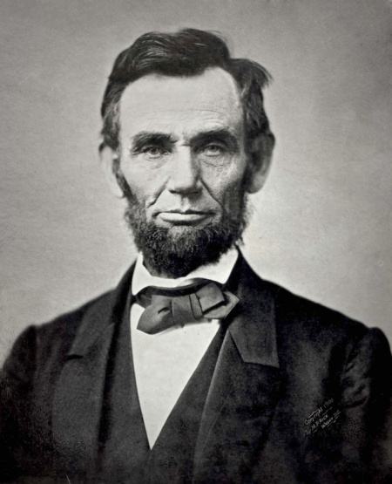
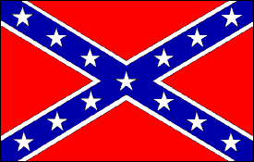
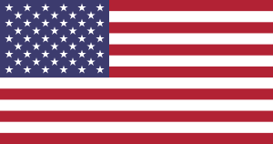
Key Period 5 Documents 11.8/11.9
Angel Herrera
Arnold Mercado

Slide 2
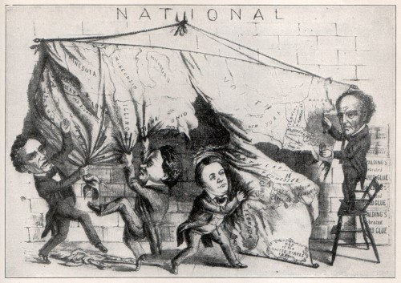
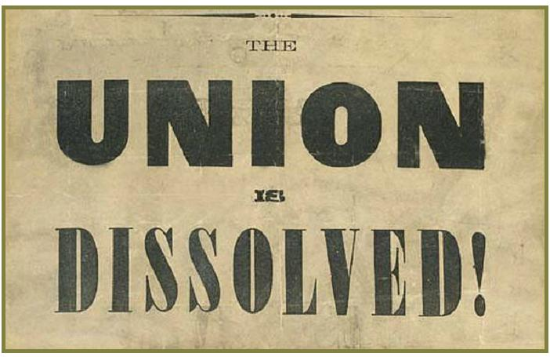
What’s Happening?
Election of 1860
South Carolina acted first, calling for a convention to SECEDE from the Union. State by state, conventions were held, and eventually the Confederacy was created
On February 4, delegates from the seceded states elect Jefferson Davis as the president of the Confederate States of America

Slide 3
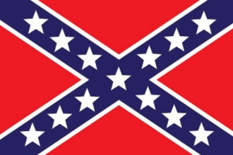
Jefferson Davis’s Inaugural Address(11.8)
Historical Context
Jefferson Davis, a senator from Mississippi before being elected as president of the Confederate States of America, delivers his inaugural address on February 18, 1861 in Montgomery, Alabama
Intended Audience
In this document, Jefferson Davis intended audience is the Northern States or the Union
Purpose
Jefferson Davis discloses why the South seceded from the Union describing it “as a necessity, not a choice”
Davis also issues a warning to the Northern States proclaiming that the North will never attack the South or “the suffering of millions will bear testimony to the [Northern] folly and wickedness”

Slide 4
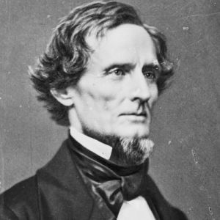
Jefferson Davis’s Inaugural Address(11.8)
Point of View
Jefferson Davis announces these claim in his inaugural address in order to proclaim the South’s independence from the Union while also asserting that they will retaliate if they deem it necessary
Outside Information/Examples
Jefferson’s argument over states’ rights echoes that of John C. Calhoun’s argument over states’ rights during the Nullification Crisis, both believed themselves to be justified in their actions and both were direct confrontations between a state(s) and the Union
Synthesis
Opponents of Federal acts prohibiting the sale and possession of marijuana in the first decade of the 21st century, and opponents of implementation of laws and regulations pertaining to firearms from the late 1900s up to 2013 both asserted the doctrine of state rights to present their opposition.

Slide 5
Abraham Lincoln’s Inaugural Address(11.9)
Historical Context
Abraham Lincoln, the newly elected President of the United States of America , delivered his first inaugural address on March 4, 1861 in Washington DC
Intended Audience
Based off the excerpts provide in the document, Lincoln’s intended audience was the Southern States
Purpose
Lincoln attempts to calm the Southern states ensuring that he will “not interfere with the institution of slavery” as it is his duty to uphold the laws of the Union
Lincoln also berates the Southern secession “describing it as the essence of anarchy” while at the same time asserting that the “momentous issue of civil war” will lie in the fault of the South as Lincoln will not assail them nor threaten them unless they attack first

Slide 6
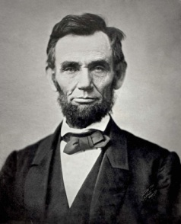
Abraham Lincoln’s Inaugural Address(11.9)
Point Of View
Abraham Lincoln takes a careful approach to the topic of the Southern secession declaring his want to preserve the Union and offers an impassioned plea to the seceded states
Outside Information/examples
It seems that Abraham Lincoln draws inspiration from multiple references most notably Henry Clay's 1850 speech on compromise and the United States Constitution.
Synthesis
Lincoln pleas of reconciliation is similar to that of the 1775 Olive Branch Petition written by the Continental Congress. Both were failed attempts at reconciliation between a group in rebellion and one that resists the rebellion they both eventually led to wars.

Slide 7
Comparison
Jefferson Davis asserted that the Confederacy had no intention of returning to the Union and that they were perfectly happy staying independent from one another whereas Lincoln sought to preserve the Union and pleaded the South to rejoin to no avail
Despite the tensions between the North and the South it was clear that neither president was interested in fighting a civil war, each refusing to attack the other unless they were attacked first, but both presidents were adamant that should it come to war that they would easily win

